Slide 1

Revolutionizing Streaming, Our Unique Platform :
WatchWave
A new era in entertainment.
By Arjun Singh Moulik Johari

Slide 2

Introduction
1
Streaming Industry
Brief overview of the streaming industry.
2
Innovation
Importance of innovation in enhancing user experience.

Slide 3
Current Landscape
Netflix's Success
Differentiation
Overview of Netflix's success and its key features.
The need for differentiation in a competitive market.

Slide 4

Proposed Features
Watch Parties
Real-Time Chat
Synchronized viewing with friends and family.
Real-time chat for interaction during shows.

Slide 5
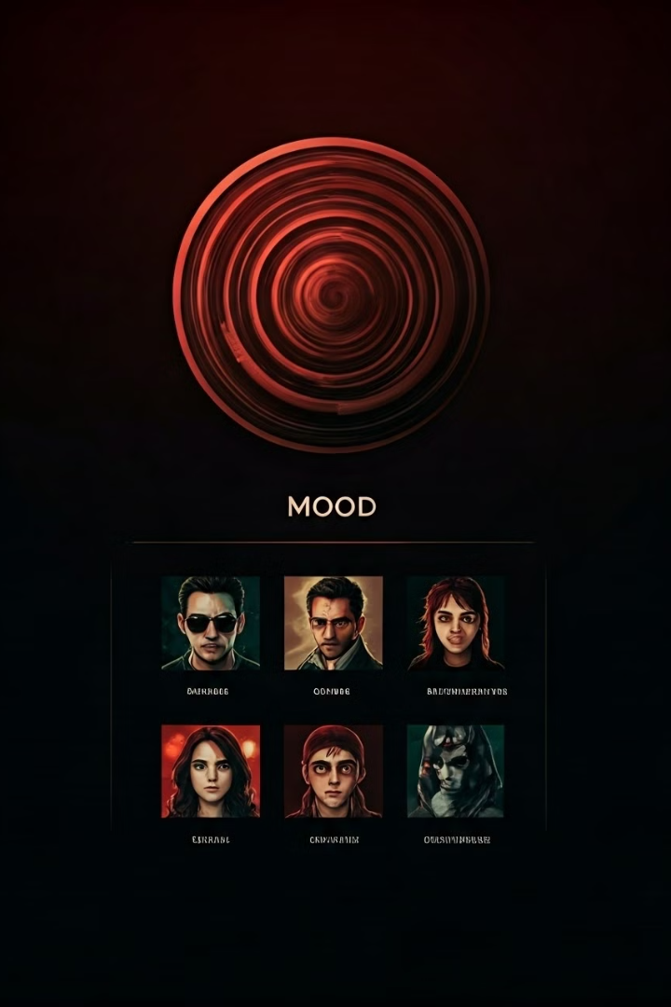
Mood-Based Recommendations
1
Mood Suggestions
Suggestions based on users' current moods.
2
User Engagement
Enhancing personalization and user engagement.

Slide 6
Pay-Per-View Options
Flexibility
Subscription Alternatives
Flexibility to rent or purchase specific titles.
Attracting users who prefer not to commit to a full subscription.

Slide 7

Fashion Integration Feature
1
Similar Outfits
2
Brand Collaborations
Purchase outfits worn by characters in shows/movies.
Collaborations with fashion brands for exclusive collections.

Slide 8

Conclusion
1
Feature Recap
Recap of proposed features and their benefits.
2
Vision
Vision for a more engaging and interactive streaming experience.

